Slide 1
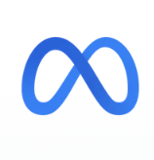

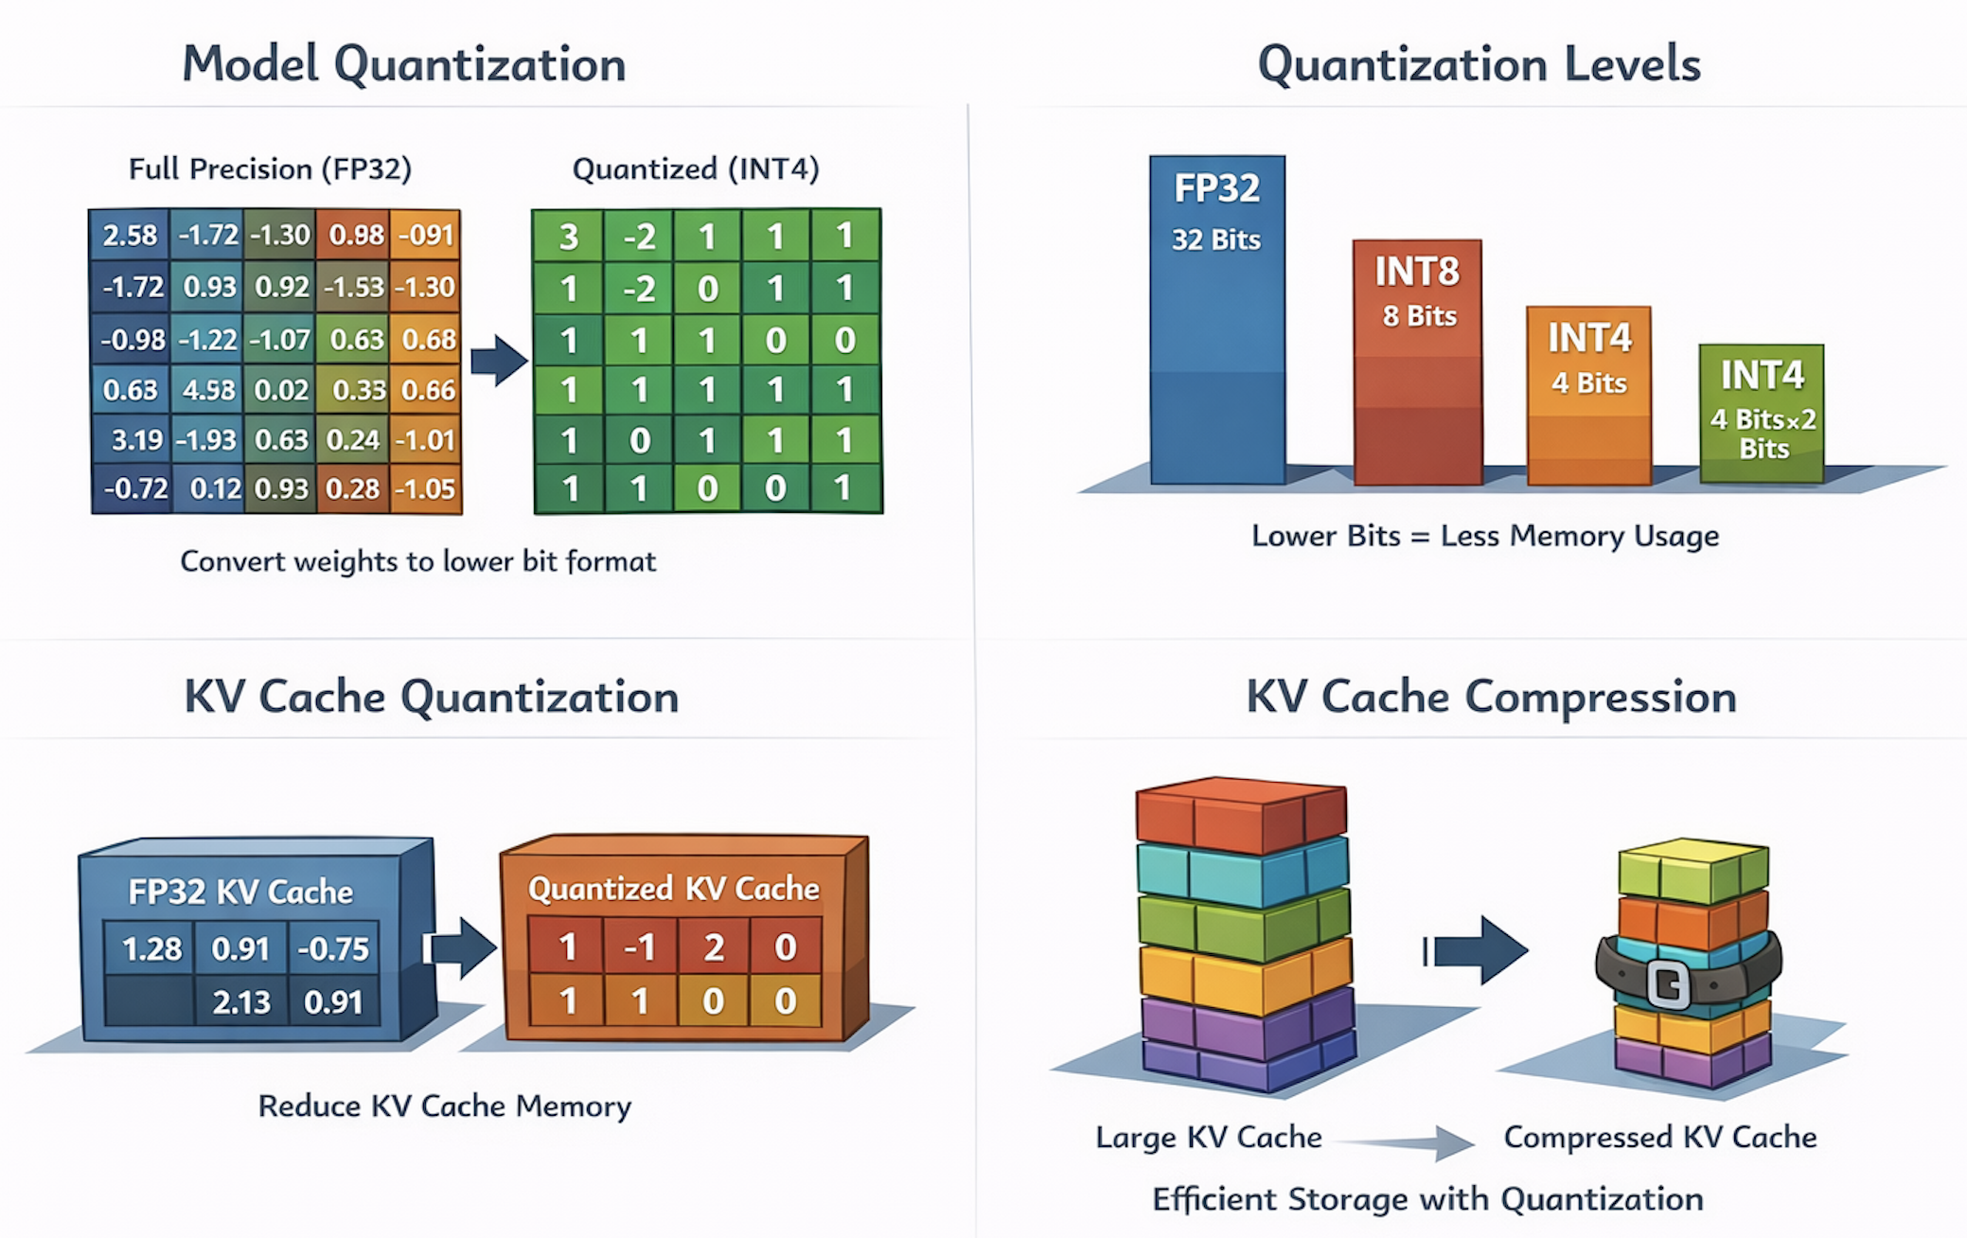
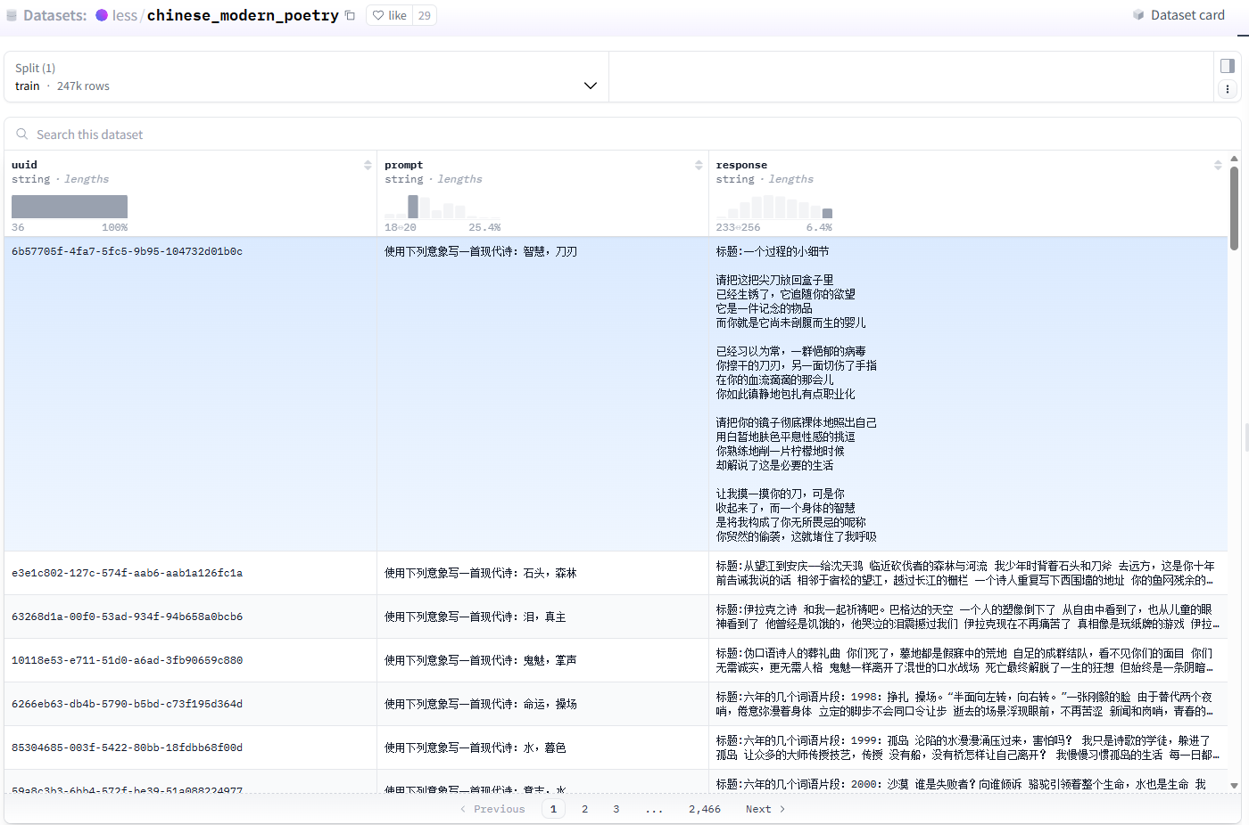
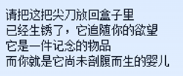
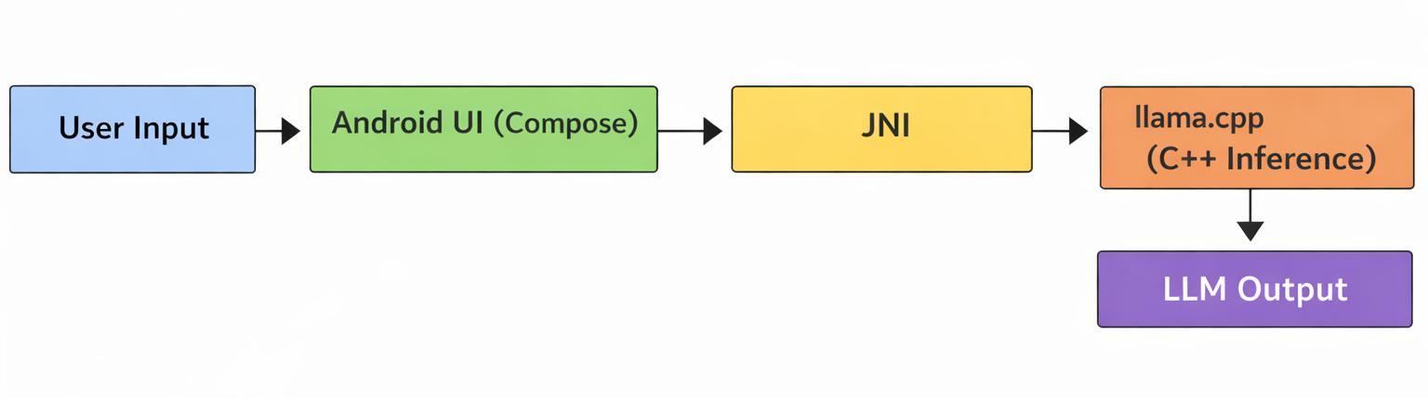
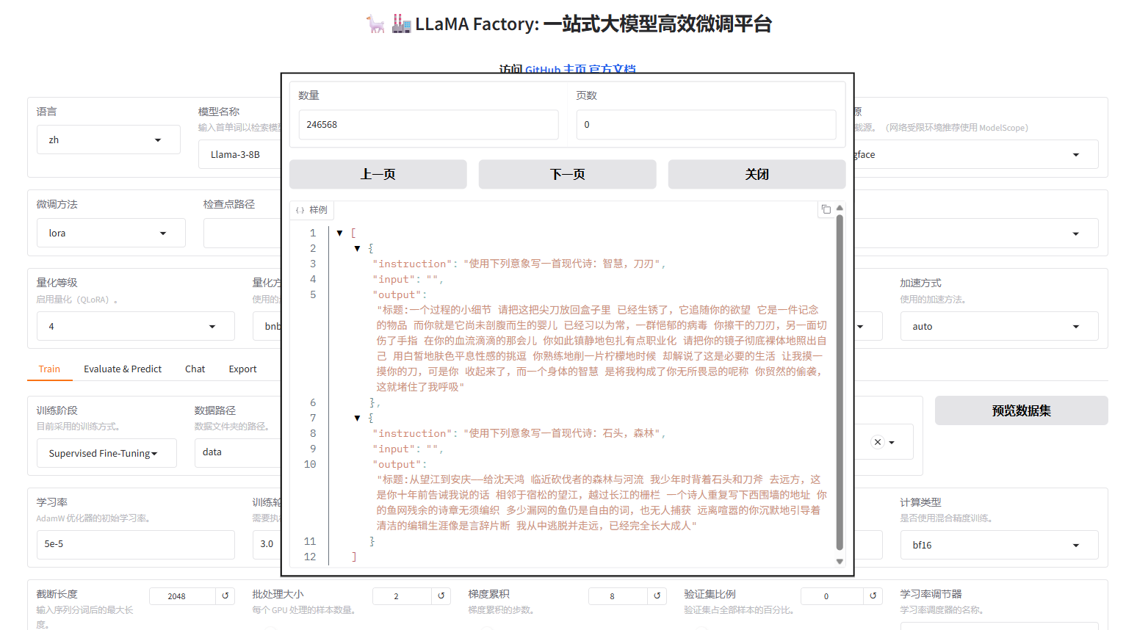
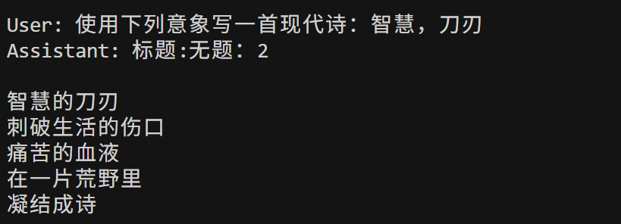
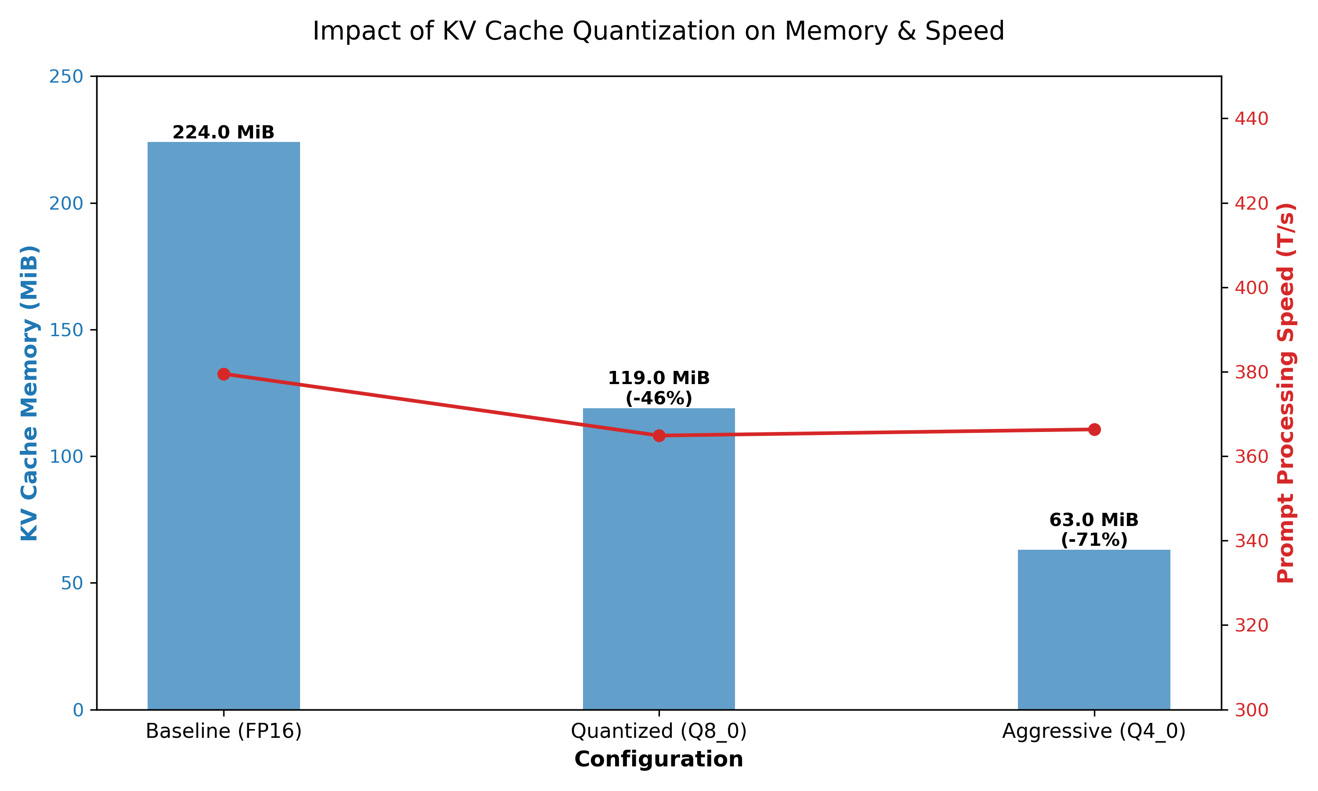
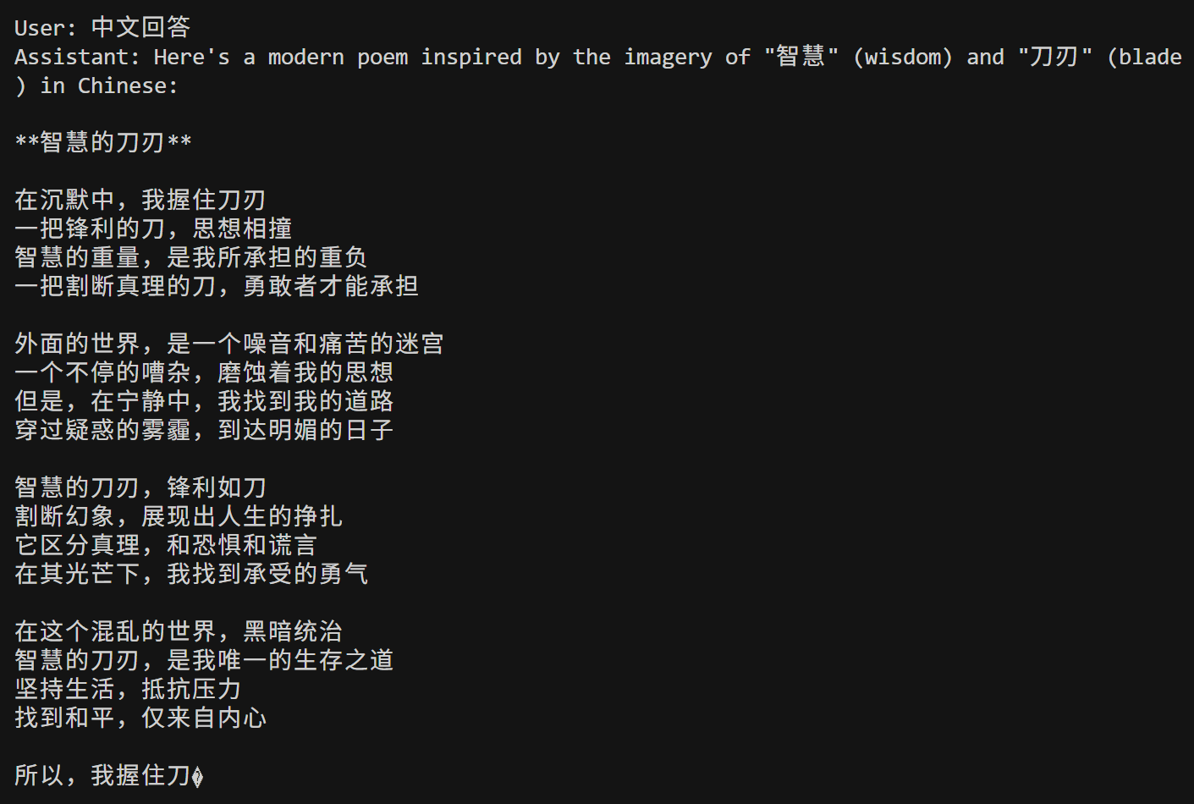
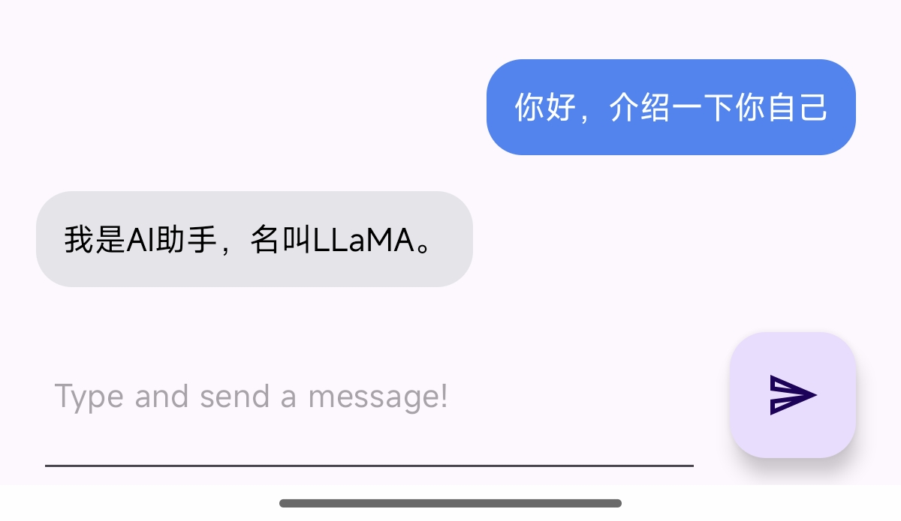
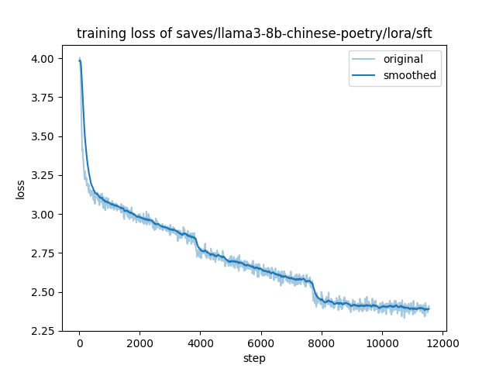
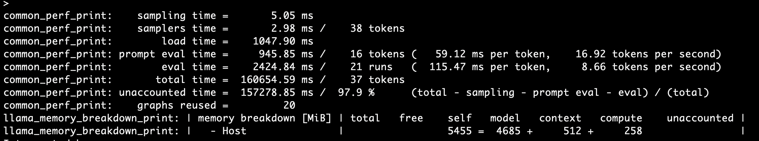
End-to-End On-device LLM System: Fine-tuning, Quantization, and Android Deployment
Ruochen Zhang, Tong Shi, Liu Yang
Model Fine-tuning
Model Optimization and Deployment Optimization
On-device LLM Inference APP
Fine-tuning Setup：
Model Quantization
Source:
llama.android
Environment:
Android Studio + NDK + CMake
Module:
Llama-3.2-3B-Instruct-Q4_K_M.gguf
Chinese poetry
KOR
Dataset
Web ui
Configuration
KV Cache Quantization
Base Model: Llama3-8B-Instruct
Technique: LoRA fine-tuning
Dataset: Chinese poetry
Visualized
Build an on-device LLM app based on llama.android (llama.cpp)
Connect C++ inference and Android UI via JNI
Run GGUF models locally on mobile devices
Performance Before vs. After Fine-tuning
Keep the same prompt：
KV Cache quantization experiment：
Befor fine-tuning
After fine-tuning
Memory usage:
Decreased from 224 MiB to 63 MiB
A reduction of up to 72%
Support 3-4 times longer contexts
Model performance:
Maximized maintained
Delivers well operational results
Successful on-device inference on a real Android smartphone(Xiaomi 14)！
Performance validation：
On-device deployment and performance results：
Quality: Improved instruction following,
coherence & novelty in poetry
Size: Adapter ~60MB, merged &
quantized to 6GB GGUF (Q4_K_M)
Deployment: Runs on mobile
(Xiaomi 14/Termux)
Training loss

